Slide 1
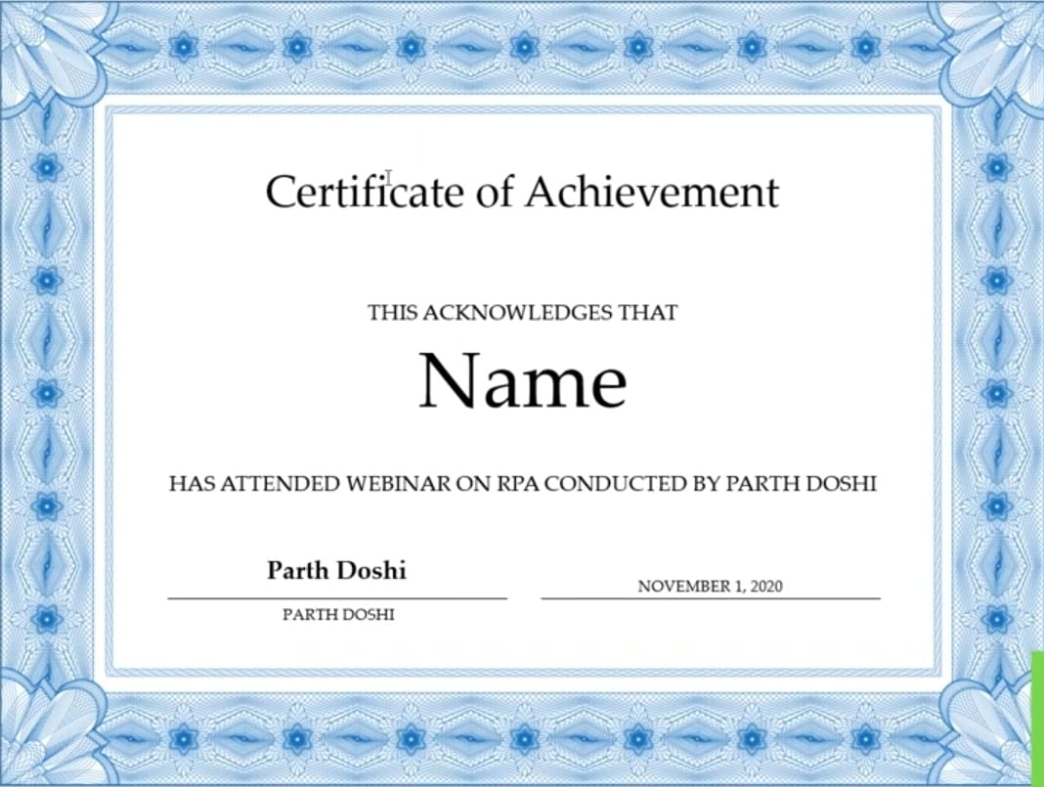
Certificate of Participation
THIS ACKNOWLEDGES THAT
Kavya Ganachari
HAS PARTICIPATED IN Hackthon CONDUCTED BY
AGM Rural College of Engineering And Technology | BRANCH: Computer science and Design Engineering
MRS. KAVITHA
SEPTEMBER 28,2026

